Slide 1
AFG31000 Series vs. AFG3000C Сравнение серий генераторов

Slide 2
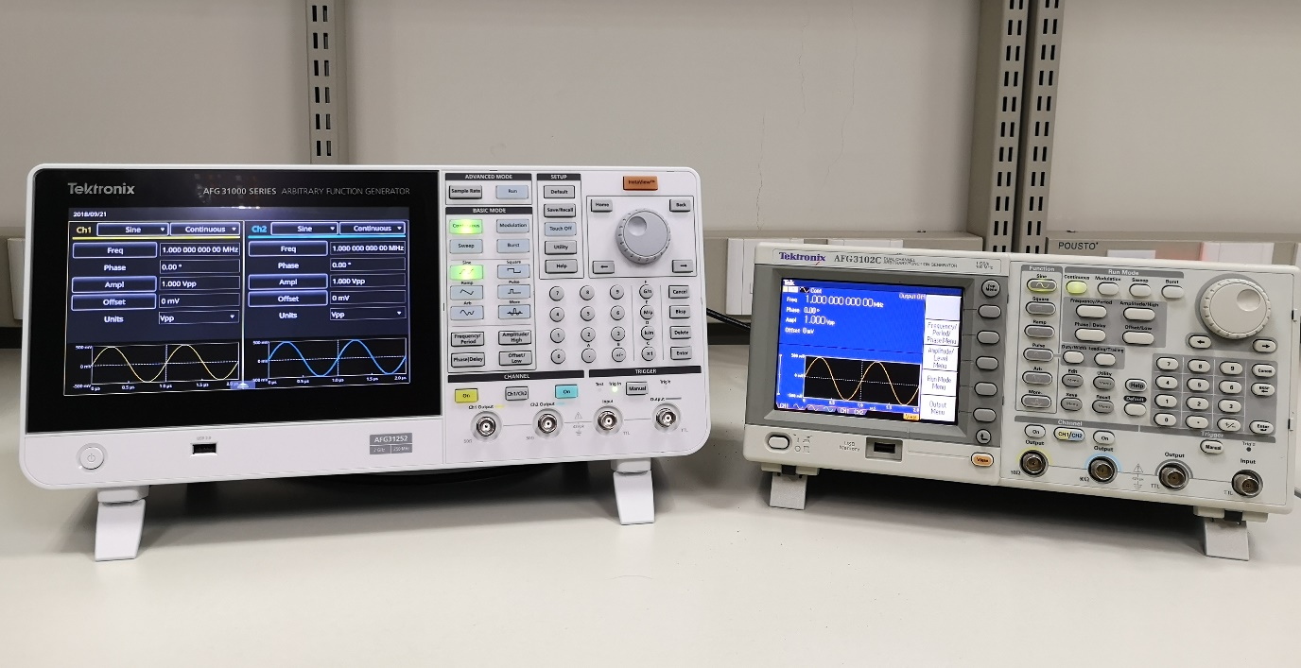
AFG31000 Series vs. AFG3000C SERIES
First Glance
Smart User Interface vs. | Legacy User Interface
Intuitive touch operation on the 9-inch touchscreen - swipe, tap, pinch-zoom, drag-drop operation | All operation is through buttons; 5.6-inch screen can only display limited information
InstaView™: Monitor waveform added at DUT in real time | Can only show nominal output waveform
Integrated waveform sequencer to generate waveform sequencing on the screen | Cannot support due to limited memory size
Integrated ArbBuilder to draw waveform with fingertips | Need ArbExpress on PC to edit and transfer the waveforms to the AFG
Outputs over voltage and current protection to minimize potential instrument damage | Short-circuit protection only
95% SCPI commands of AFG31K are compatible with AFG3KC. Refer to the application note for more details.

Slide 3
AFG31000 Series vs. AFG3000C SERIES
BANNER Specifications
Specifications | AFG31000 Series | AFG3000C Series
Sine freq range | 25/50/100/150/250 MHz | 25/50/100/150/240 MHz
Sine amp range (into 50ohm load) | 1mVp-p ~ 10 Vp-p (25/50 MHz models) 1mVp-p ~ 6Vp-p ( 100MHz model @ 100MHz) 1mVp-p ~ 5 Vp-p ( 150MHz model @ 150MHz) 1mVp-p~ 4Vp-p (250MHz model @250MHz) | 10mVp-p ~ 10 Vp-p (25MHz/50MHz models) 20mVp-p ~ 10 Vp-p (100MHz model) 20mVp-p ~ 8 Vp-p (150MHz model @ 150MHz) 50mVp-p ~ 4 Vp-p (240MHz model @ 240MHz)
Square/pulse freq range | 25/40/80/120/160 MHz | 25/40/50/100/120 MHz
Edge time | 7 ns/ 5 ns/ 3.5 ns/ 3 ns/ 2 ns | 9 ns/ 7 ns/5 ns/3.5 ns/2.5 ns
Jitter (typ.) | 2.5ps | 100 ps
Resolution | 14-bit | 14-bit
Waveform length | 16 Mpts std., 128 Mpts opt. | 128 Kpts
Display | 9-in 800x480 capacitive touch screen | 5.6 in. Color TFT LCD

